Slide 1
Text Mining

Slide 2
Text Mining
Text mining is about looking for patterns in natural language text
A process of finding interesting regularities in large textual datasets.
Where interesting means: non-trivial, hidden, previously unknown and potentially useful

Slide 3
Data Mining vs. Text Mining
Data Mining
Identify data sets
Select features
Prepare data
Analyze distribution
Text Mining
Identify documents
Extract features
Select features by algorithm
Prepare data
Analyze distribution

Slide 4
Text Mining Applications
Customer profile analysis
mining incoming emails for customers' complaint and feedback.
Patent analysis
analyzing patent databases for major technology players, trends, and opportunities.
Information dissemination
organizing and summarizing trade news and reports for personalized information services.
Company resource planning
mining a company's reports and correspondences for activities, status, and problems reported.

Slide 5
Why dealing with Text is Tough?
Abstract concepts are difficult to represent
“Countless” combinations of subtle, abstract relationships among concepts
Many ways to represent similar concepts
E.g. space ship, flying saucer, UFO
Concepts are difficult to visualize
High dimensionality
Tens or hundreds of thousands of features

Slide 6
Why dealing with Text is Easy?
Highly redundant data
…most of the methods count on this property
Just about any simple algorithm can get “good” results for simple tasks:
Pull out “important” phrases
Find “meaningfully” related words
Create some sort of summary from documents

Slide 7
Who is in the text analysis arena?
Knowledge Rep. &
Reasoning / Tagging
Search & DB
Semantic Web
Web2.0
Information
Retrieval
Computational
Linguistics
Text Analytics
Data Analysis
Natural Language
Processing
Machine Learning
Text Mining

Slide 8
What dimensions are in text analytics?
Three major dimensions of text analytics:
Representations
…from character-level to first-order theories
Techniques
…from manual work, over learning to reasoning
Tasks
…from search, over (un-, semi-) supervised learning, to visualization, summarization, translation …

Slide 9
How do we represent text?
Levels of text representations
Character (character n-grams and sequences)
Words (stop-words, stemming, lemmatization)
Phrases (word n-grams, proximity features)
Part-of-speech tags
Taxonomies / thesauri
Vector-space model
Language models
Full-parsing
Cross-modality
Lexical
Syntactic

Slide 10
Character level
Character level representation of a text consists from sequences of characters…
…a document is represented by a frequency distribution of sequences
Usually we deal with contiguous strings…
…each character sequence of length 1, 2, 3, … represent a feature with its frequency

Slide 11
Good and bad sides
Representation has several important strengths:
…it is very robust since avoids language morphology
(useful for e.g. language identification)
…it captures simple patterns on character level
(useful for e.g. spam detection, copy detection)
…because of redundancy in text data it could be used for many analytic tasks
(learning, clustering, search)
It is used as a basis for “string kernels” in combination with SVM for capturing complex character sequence patterns
…for deeper semantic tasks, the representation is too weak

Slide 12
Word level
The most common representation of text used for many techniques
…there are many tokenization software packages which split text into the words

Slide 13
Words Properties
Relations among word surface forms and their senses:
Homonomy: same form, but different meaning (e.g. bank: river bank, financial institution)
Polysemy: same form, related meaning (e.g. bank: blood bank, financial institution)
Synonymy: different form, same meaning (e.g. singer, vocalist)
Hyponymy: one word denotes a subclass of an another (e.g. breakfast, meal)
Word frequencies in texts have power distribution:
…small number of very frequent words
…big number of low frequency words

Slide 14
Stop-words
Stop-words are words that from non-linguistic view do not carry information
…they have mainly functional role
…usually we remove them to help the methods to perform better
Stop words are language dependent – examples:
English: A, ABOUT, ABOVE, ACROSS, AFTER, AGAIN, AGAINST, ALL, ALMOST, ALONE, ALONG, ALREADY, ...
French: la, été, tu, comme, …

Slide 15
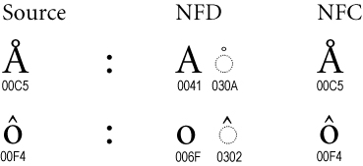
Word character level normalization
Hassle which we usually avoid:
Since we have plenty of character encodings in use, it is often nontrivial to identify a word and write it in unique form
…e.g. in Unicode the same word could be written in many ways – canonization of words:
https://unicode.org/reports/tr15/

Slide 16
Stemming
Different forms of the same word are usually problematic for text data analysis, because they have different spelling and similar meaning (e.g. learns, learned, learning,…)
Stemming is a process of transforming a word into its stem (normalized form)
…stemming provides an inexpensive mechanism to merge

Slide 17
Stemming
For English we mostly used Porter stemmer http://www.tartarus.org/~martin/PorterStemmer/
Example cascade rules used in English Porter stemmer
ATIONAL -> ATE relational -> relate
TIONAL -> TION conditional -> condition
ENCI -> ENCE valenci -> valence
ANCI -> ANCE hesitanci -> hesitance
IZER -> IZE digitizer -> digitize
ABLI -> ABLE conformabli -> conformable
ALLI -> AL radicalli -> radical
ENTLI -> ENT differentli -> different
ELI -> E vileli -> vile
OUSLI -> OUS analogousli -> analogous

Slide 18
Phrase level
Instead of having just single words we can deal with phrases
We use two types of phrases:
Phrases as frequent contiguous word sequences
Phrases as frequent non-contiguous word sequences
The main effect of using phrases is to more precisely identify sense

Slide 19
Google n-gram corpus
In September 2006 Google announced availability of n-gram corpus:
http://googleresearch.blogspot.com/2006/08/all-our-n-gram-are-belong-to-you.html#links
Some statistics of the corpus:
File sizes: approx. 24 GB compressed text files
Number of tokens: 1,024,908,267,229
Number of sentences: 95,119,665,584
Number of unigrams: 13,588,391
Number of bigrams: 314,843,401
Number of trigrams: 977,069,902
Number of fourgrams: 1,313,818,354
Number of fivegrams: 1,176,470,663

Slide 20
Part-of-Speech level
By introducing part-of-speech tags we introduce word-types enabling to differentiate words functions
For text-analysis part-of-speech information is used mainly for “information extraction” where we are interested in e.g. named entities which are “noun phrases”
Another possible use is reduction of the vocabulary (features)
…it is known that nouns carry most of the information in text documents

Slide 21
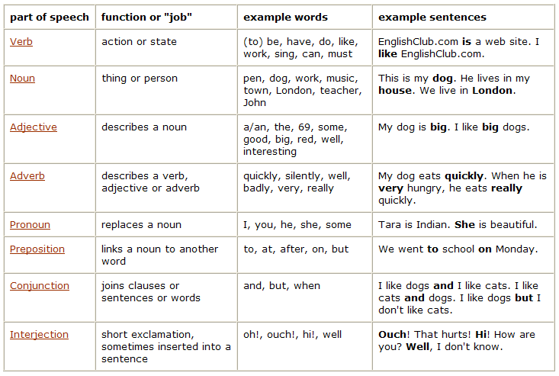
Part-of-Speech Table

Slide 22
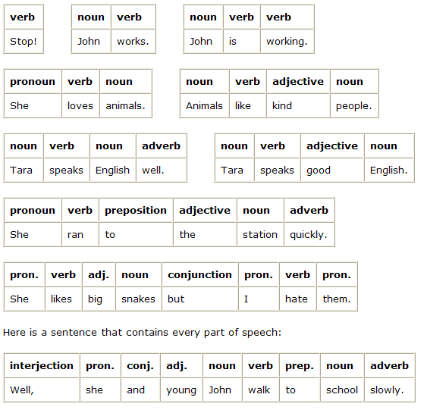
Part-of-Speech examples

Slide 23
Taxonomies/thesaurus level
Thesaurus has a main function to connect different surface word forms with the same meaning into one sense (synonyms)
…additionally we often use hypernym relation to relate general-to-specific word senses
…by using synonyms and hypernym relation we compact the feature vectors
The most commonly used general thesaurus is WordNet which exists in many other languages (e.g. EuroWordNet)
http://www.illc.uva.nl/EuroWordNet/

Slide 24
WordNet – database of lexical relations
WordNet is the most well developed and widely used lexical database for English
…it consist from 4 databases (nouns, verbs, adjectives, and adverbs)
Each database consists from sense entries – each sense consists from a set of synonyms, e.g.:
musician, instrumentalist, player
person, individual, someone
life form, organism, being
Category | Unique Forms | Number of Senses
Noun | 94474 | 116317
Verb | 10319 | 22066
Adjective | 20170 | 29881
Adverb | 4546 | 5677

Slide 25
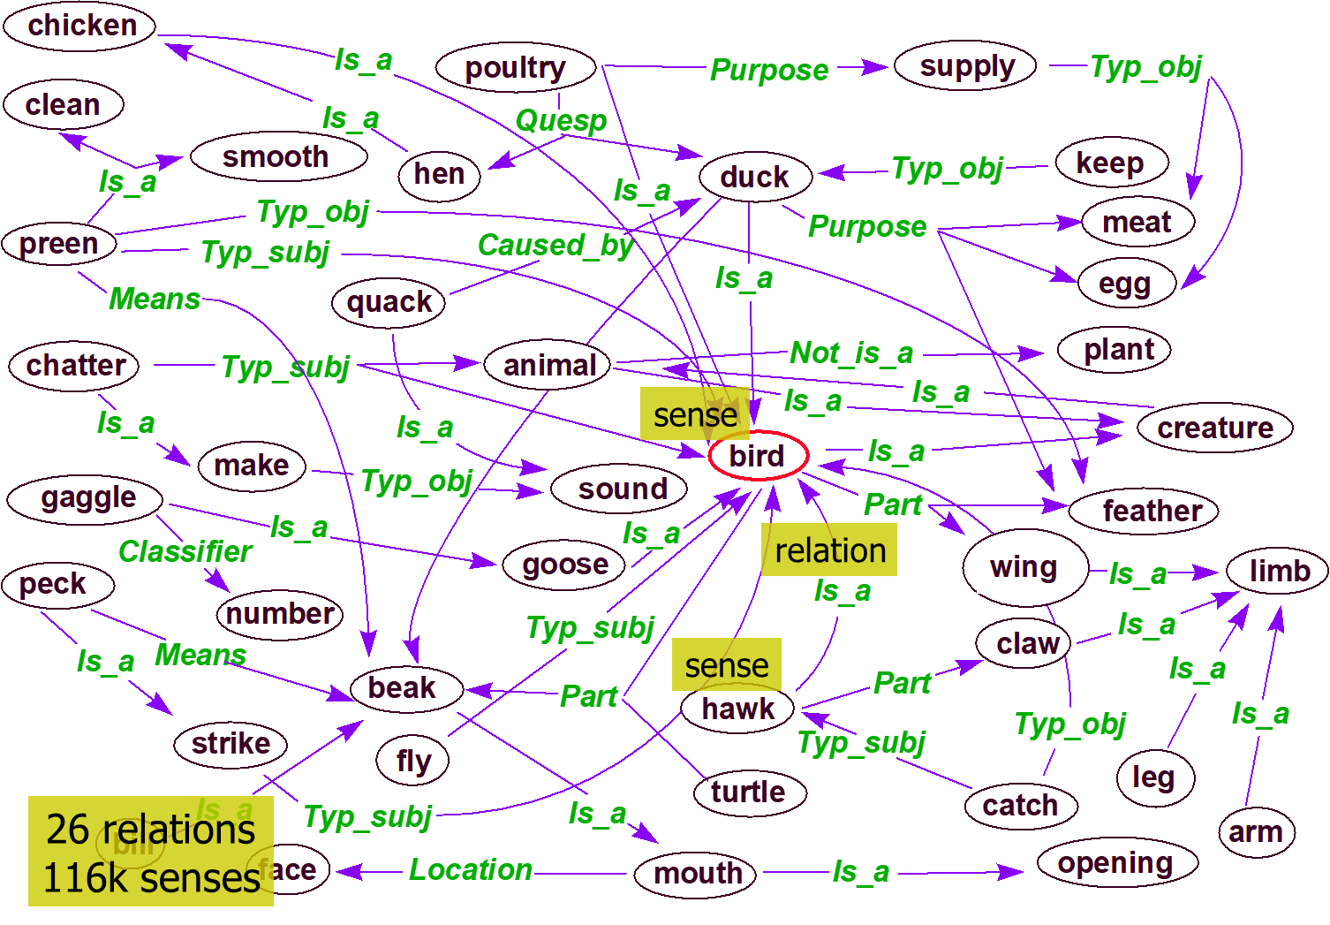
WordNet – excerpt from the graph

Slide 26
WordNet relations
Each WordNet entry is connected with other entries in the graph through relations
Relations in the database of nouns:
Relation | Definition | Example
Hypernym | From lower to higher concepts | breakfast -> meal
Hyponym | From concepts to subordinates | meal -> lunch
Has-Member | From groups to their members | faculty -> professor
Member-Of | From members to their groups | copilot -> crew
Has-Part | From wholes to parts | table -> leg
Part-Of | From parts to wholes | course -> meal
Antonym | Opposites | leader -> follower

Slide 27
Vector-space model level
The most common way to deal with documents is first to transform them into sparse numeric vectors and then deal with them with linear algebra operations
…by this, we forget everything about the linguistic structure within the text
…this is sometimes called “structural curse” because this way of forgetting about the structure doesn’t harm efficiency of solving many relevant problems
This representation is referred to also as “Bag-of-Words” or “Vector-Space-Model”
Typical tasks on vector-space-model are classification, clustering, visualization etc.

Slide 28
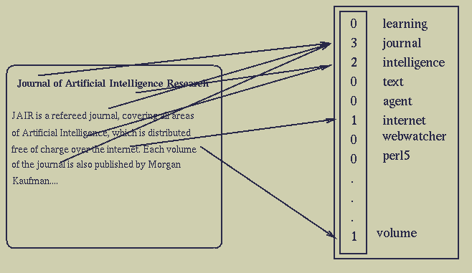
Bag-of-words document representation

Slide 29
Word weighting
In the bag-of-words representation each word is represented as a separate variable having numeric weight (importance)
The most popular weighting schema is normalized word frequency TFIDF:
Tf(w) – term frequency (number of word occurrences in a document)
Df(w) – document frequency (number of documents containing the word)
N – number of all documents
TfIdf(w) – relative importance of the word in the document
The word is more important if it appears
several times in a target document
The word is more important if it appears in less documents

Slide 30
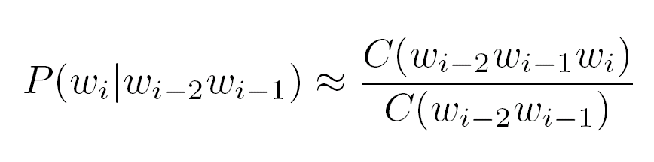
Language model level
Language modeling is about determining probability of a sequence of words
The task typically gets reduced to the estimating probabilities of a next word given two previous words (trigram model):
It has many applications including speech recognition, OCR, handwriting recognition, machine translation and spelling correction
Frequencies
of word
sequences

Slide 31
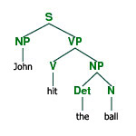
Full-parsing
Parsing provides maximum structural information per sentence
On the input we get a sentence, on the output we generate a parse tree
For most of the methods dealing with the text data the information in parse trees is too complex

Slide 32
Cross-modality level
It is very often the case that objects are represented with different data types:
Text documents
Multilingual texts documents
Images
Video
Social networks
Sensor networks
…the question is how to create mappings between different representation so that we can benefit using more information about the same objects

Slide 33
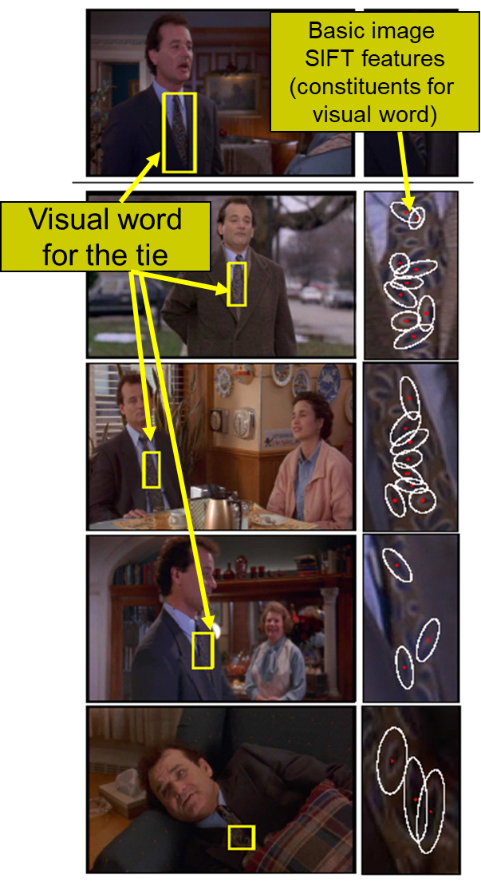
Example: Aligning text with audio, images and video
The word “tie” has several representations (http://www.answers.com/tie&r=67)
Textual
Multilingual text
(tie, kravata, krawatte, …)
Audio
Image:
http://images.google.com/images?hl=en&q=necktie
Video (movie on the right)
Out of each representation we can get set of features and the idea is to correlate them
KCCA (Kernel Correlation Analysis) method generates mappings between different representations into “modality neutral” data representation

Slide 34
Typical tasks on text
Document Categorization Task
Document Clustering
Latent Semantic Indexing
Visualization

